Slide 1
Lit Elements pt 1 – Basics
Encapsulated, single-responsibility, reusable code

Slide 2

Contents
What is lit elements?
What is different from web components?
How to use it?

Slide 3
What is lit elements
Lit is a simple library that can be used to create lightweight custom web components.
It builds on (custom) web components
Make the process more simple
Adds a lot of standard functionality

Slide 4
How do you make a lit element app?
Assignment:
Use Vitejs to create a lit element project
Remove the counter.js code example
Add a HelloWorld component
Use the HelloWorld component in the template

Slide 5
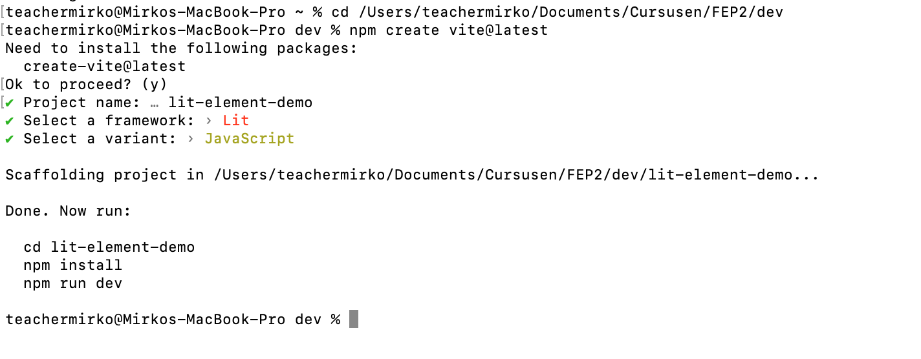
How do you make a lit element app?
We use vite to create a lit element project
Open a terminal window and navigate to your dev folder
Issue the following command:
npm create vite@latest

Slide 6
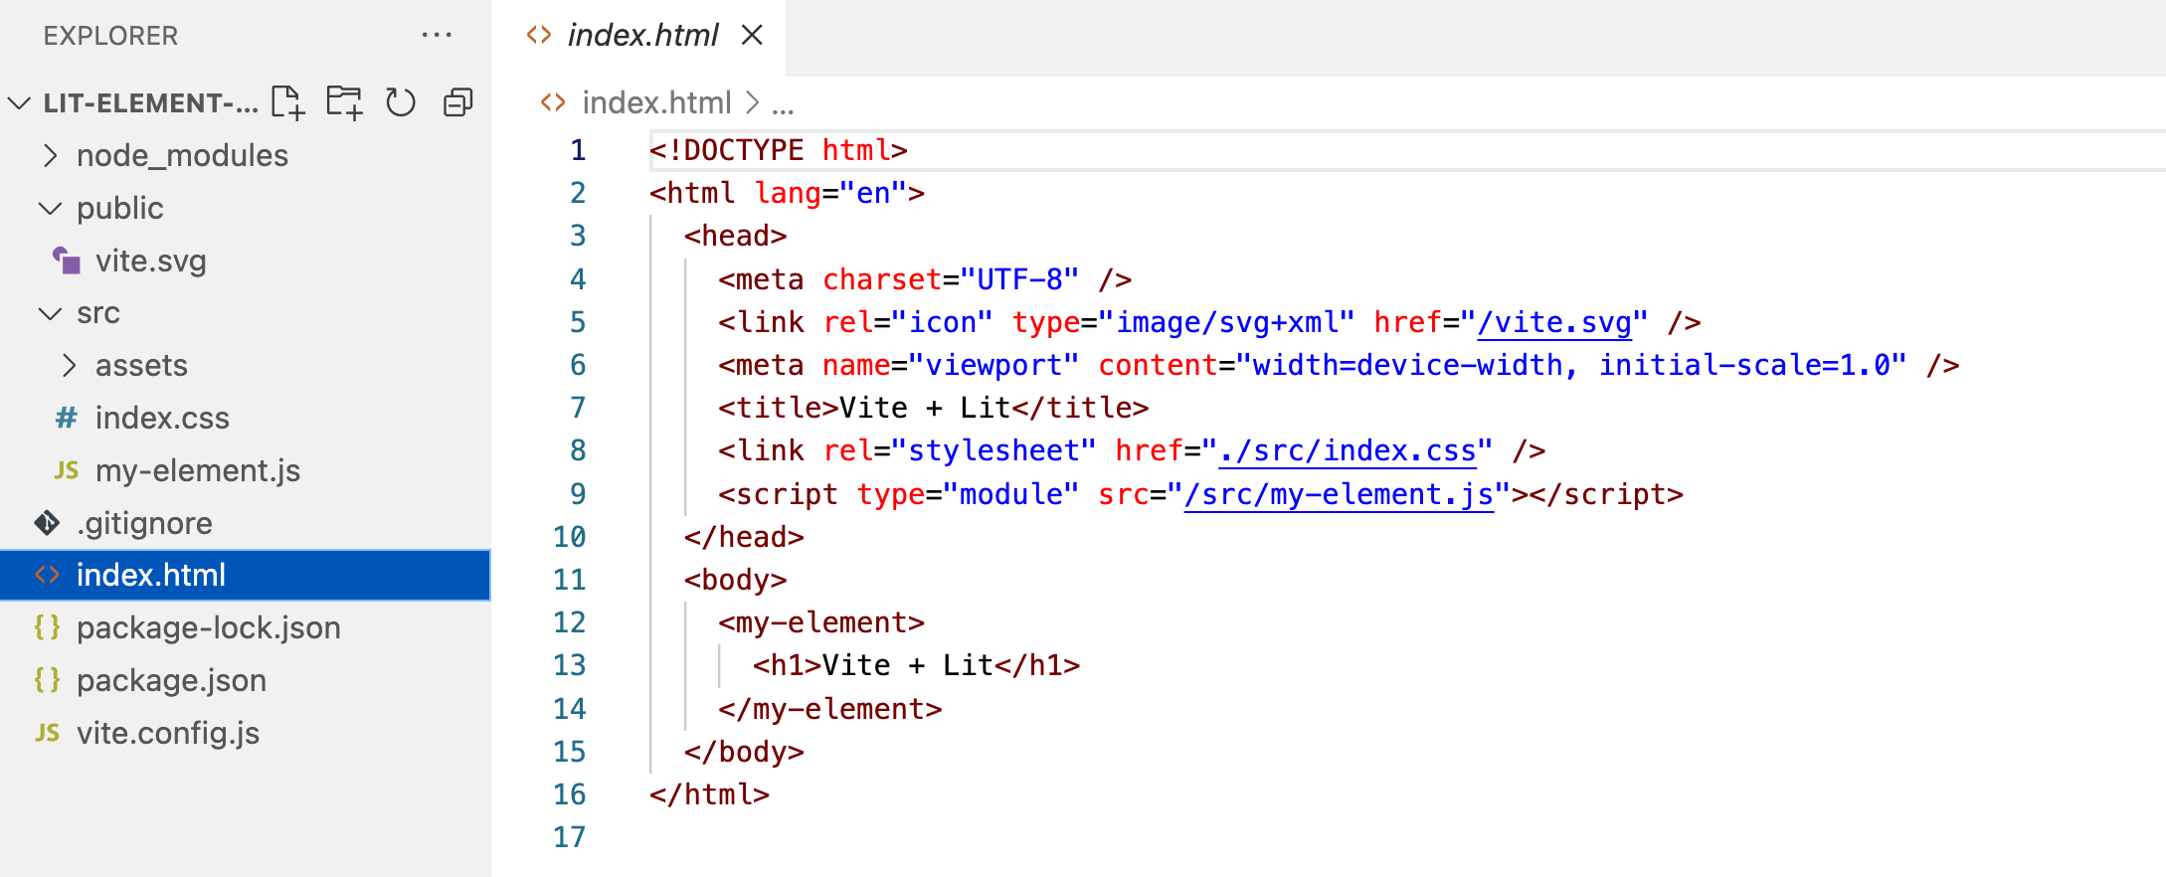
Open the project in VSC
Here is our lit element

Slide 7
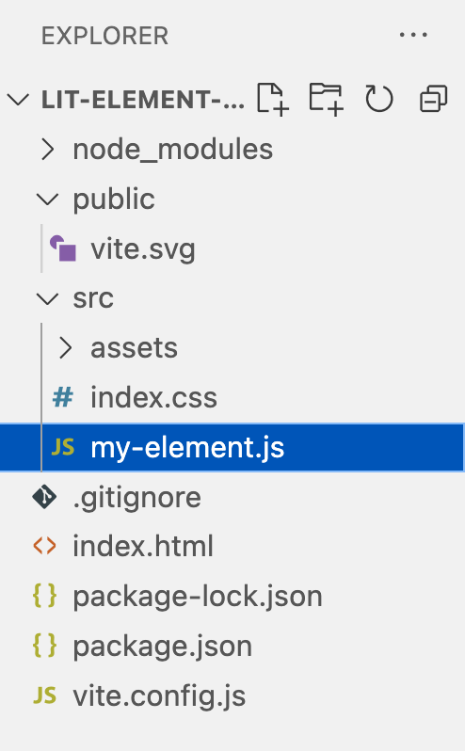
Open the project in VSC
import { LitElement, css, html } from 'lit’
export class MyElement extends LitElement {
static get properties() {…}
constructor() {…}
render() {…}
_onClick() {…}
static get styles() {…}
}
window.customElements.define('my-element', MyElement)
Code removed for clarity

Slide 8
get properties()
Defines which html attributes are mapped on what properties
static get properties() {
return {
docsHint: { type: String },
count: { type: Number }
}
}
You can set a starting value for the timer
<my-element count="66">
<h1>Vite + Lit</h1>
</my-element>
Properties have a type!

Slide 9
constructor()
Always call super()
constructor() {
super()
this.docsHint = 'Click on the Vite and Lit logos to learn more’
this.count = 0
}
Initialise properties
Will this be execute before or after get properties() ?

Slide 10
render()
Returns a html template
render() {
return html`
<div>
<a href="https://vitejs.dev" target="_blank">
<img src="/vite.svg" class="logo" alt="Vite logo" />
</a>
<a href="https://lit.dev" target="_blank">
<img src=${litLogo} class="logo lit" alt="Lit logo" />
</a>
</div>
<slot></slot>
<div class="card">
<button @click=${this._onClick} part="button">
count is ${this.count}
</button>
</div>
<p class="read-the-docs">${this.docsHint}</p>`
}
Can use the properties!

Slide 11
_onClick()
a hook that reacts to a mouse click.
_onClick() {
this.count++
}
Notice that the render function is NOT called
lit will automatically call the render fuinction when a property changes

Slide 12
get styles()
Returns the component css
static get styles() {
return css`
h1 {
font-size: 3.2em;
line-height: 1.1;
}
`
}

Slide 13
Documentatie
Lit website:
https://lit.dev/
Lit Youtube channel:
https://www.youtube.com/channel/UCok4ZKSzM3jY7JQRMlF-DPg

Slide 14
Conclusion
lit element creates custom web components
A render() function is added
called when a property changes
Event handler hooks
html template
css code

